Slide 1

Introduction to Mobile Development on AWS
Name
Title
Twitter - @handle

Slide 2





The market is growing. How will you innovate?
5B (+1.2B)
Mobile internet users by 2025
3.6 hours
Daily time on mobile per user
24 GB (+17 GB)
Monthly mobile data usage per subscriber by 2024
25%
Apps abandoned after first use
4M+
Apps published to global app stores you need to compete with for mindshare
Source: GSMA
Source: Mary Meeker’s Internet Trends 2019
Source: GSMA

Slide 3





To meet and exceed user expectations, the modern mobile/web app must solve numerous challenges
Platform(s)
Native mobile and web app?
Differentiation
Innovative & new ways to interact
How can your app stand out?
Screen & mobility
Responsive & progressive
Always available, even offline
Security
AuthN and AuthZ by default
Data layer
Instantaneous, with real-time feedback
Network friendly (less calls / more data / just right)
Time to market
Iterative, full stack development
Developer productivity & team workflows

Slide 4


AWS provides developers the capabilities to exceed user expectations
App features and platforms
Developer lifecycle
Secure, offline, real-time data

Slide 5
Apps features and platforms

Slide 6
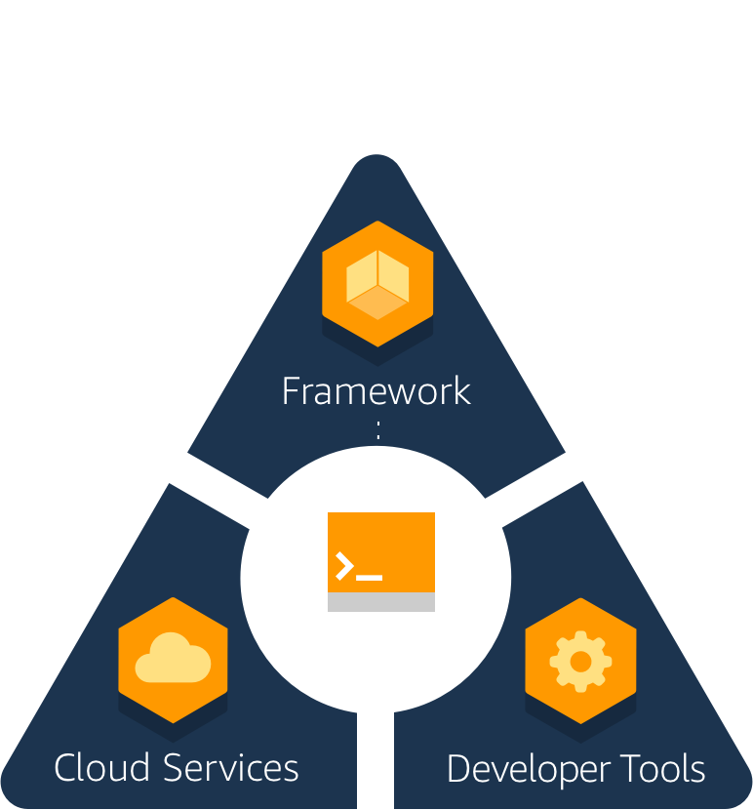
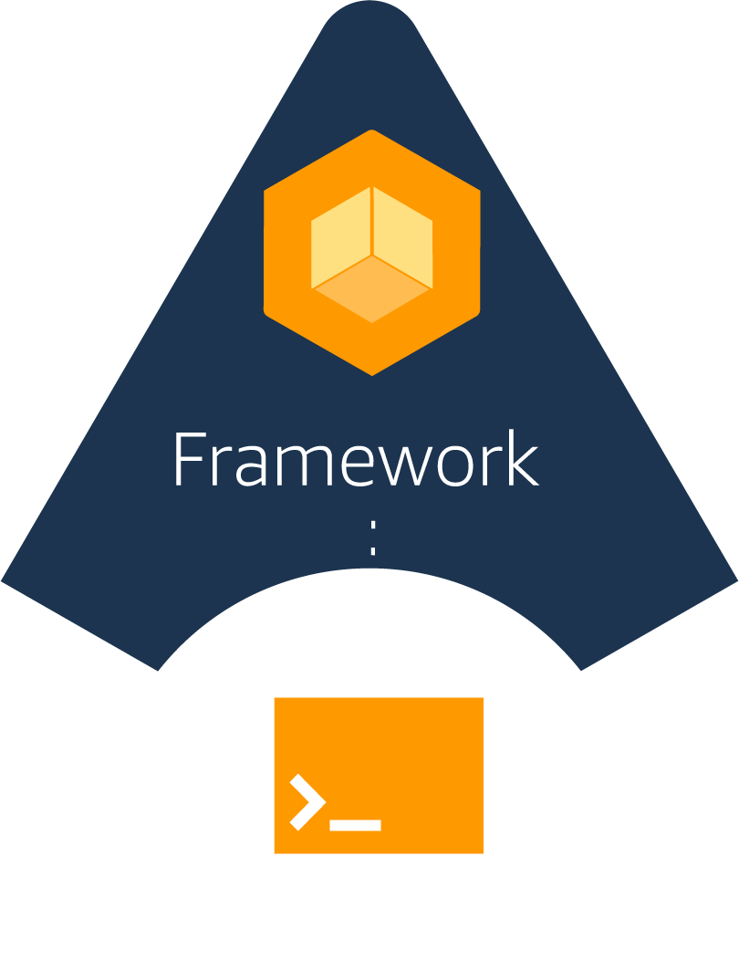


AWS Amplify overview
Broad support for the most popular OS platforms and frameworks
The Amplify Framework, an open-source client framework, includes libraries, a CLI toolchain, and UI components
The CLI toolchain enables easy integration with AWS services such as Amazon Cognito, AWS AppSync, and Amazon Pinpoint
Developer tools for building, testing, deploying, and hosting the entire app – frontend and backend

Slide 7

Amplify Framework
Open source (top 5 fastest growing project on GitHub)
Opinionated
Categories based high level abstractions
Declarative
Best practices built-in
Escape hatches

Slide 8

Amplify Framework - Capabilities
DataStore
On-device persistent storage that automatically synchronizes data between you apps and the cloud.
Predictions
Add MI/ML capabilities to your app powered by cloud services
Analytics
Track user sessions, custom user attributes and in-app metrics
API
HTTP requests using REST and GraphQL with support for real-time data
Auth
AuthN + AuthZ library with prebuilt UI components for your app
Interactions
Conversational bots powered by deep learning technologies
PubSub
Connect your app to message-oriented middleware on the cloud
Notifications
Push notifications with campaign analytics and targeting
Storage
Manage user content securely in public, protected, and private storage.
XR
Work with augmented reality and virtual reality content in your apps

Slide 9
Amplify iOS and Android (preview)

Slide 10

How is this different?
Amplify Clients
Use-case centric
Declarative abstractions
Xcode/Android Studio integration
(E.g. Storage.put())
AWS Mobile SDKs
AWS Service centric
Low level generated
(E.g. AWSS3TransferUtilityUploadExpression)
Both can be used in the same app.

Slide 11
Amplify CLI

Slide 12

Amplify Framework
CLI
Create and manage your backend
Categories
Multiple environments
GraphQL Transform
Plugins
Notes:
GraphQL transform you can define your application data mode using GraphQL SDL ad the library handles converting your SDL definition in to full descriptive AWS CloudFormtaion +
Codegen helps you generate native code for iOS and Android, as well as types for Flow and TypeScript. It can also generate GraphQL statements(queries, mutations, and subscriptions) so that you don’t have to hand code them.

Slide 13
Amplify CLI
Categories
Auth (AuthN+AuthZ) Predictions (AI/ML)
Analytics Serverless Functions
API (GraphQL/REST) Storage
Interactions (chat bots) XR (AR/VR)

Slide 14
Amplify CLI
$ amplify add auth
$ amplify push
$ amplify configure auth
$ amplify remove auth
$ amplify delete

Slide 15
Amplify CLI
Multiple environments
$ amplify env add
$ amplify env list
$ amplify env checkout
$ amplify env remove

Slide 16
Amplify Client Libraries

Slide 17










Amplify Framework
Client libraries
Connect and interact with cloud services from your app
Platforms: iOS, Android, Web
JS Frameworks: React Native, React, Angular, Vue, and Ionic
Category based

Slide 18
Amplify Client Libraries
Categories
Auth (AuthN+AuthZ) Predictions (AI/ML)
Analytics PubSub
API (GraphQL) Push Notifications
API (REST) Storage
Interactions (chat bots) XR (AR/VR)

Slide 19
Amplify iOS
Setup (Cocoapods)
pod ‘amplify-tools’
pod ’Amplify’
pod 'AmplifyPlugins/AWSS3StoragePlugin'
Usage
import Amplify
let storagePlugin = AWSS3StoragePlugin()
try! Amplify.add(plugin: storagePlugin)
Amplify.Storage.putData(
key: filename, data: uploadData, options: options)

Slide 20
Developer lifecycle

Slide 21

AWS Amplify Console
Git-based workflow for full-stack apps
Simplified CI/CD
Easy custom domains
Instant atomic deployments

Slide 22
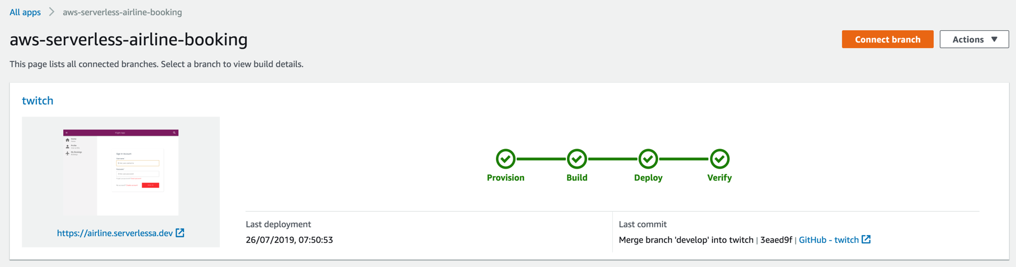
AWS Amplify Console
Git-based CI/CD for full-stack serverless apps

Slide 23
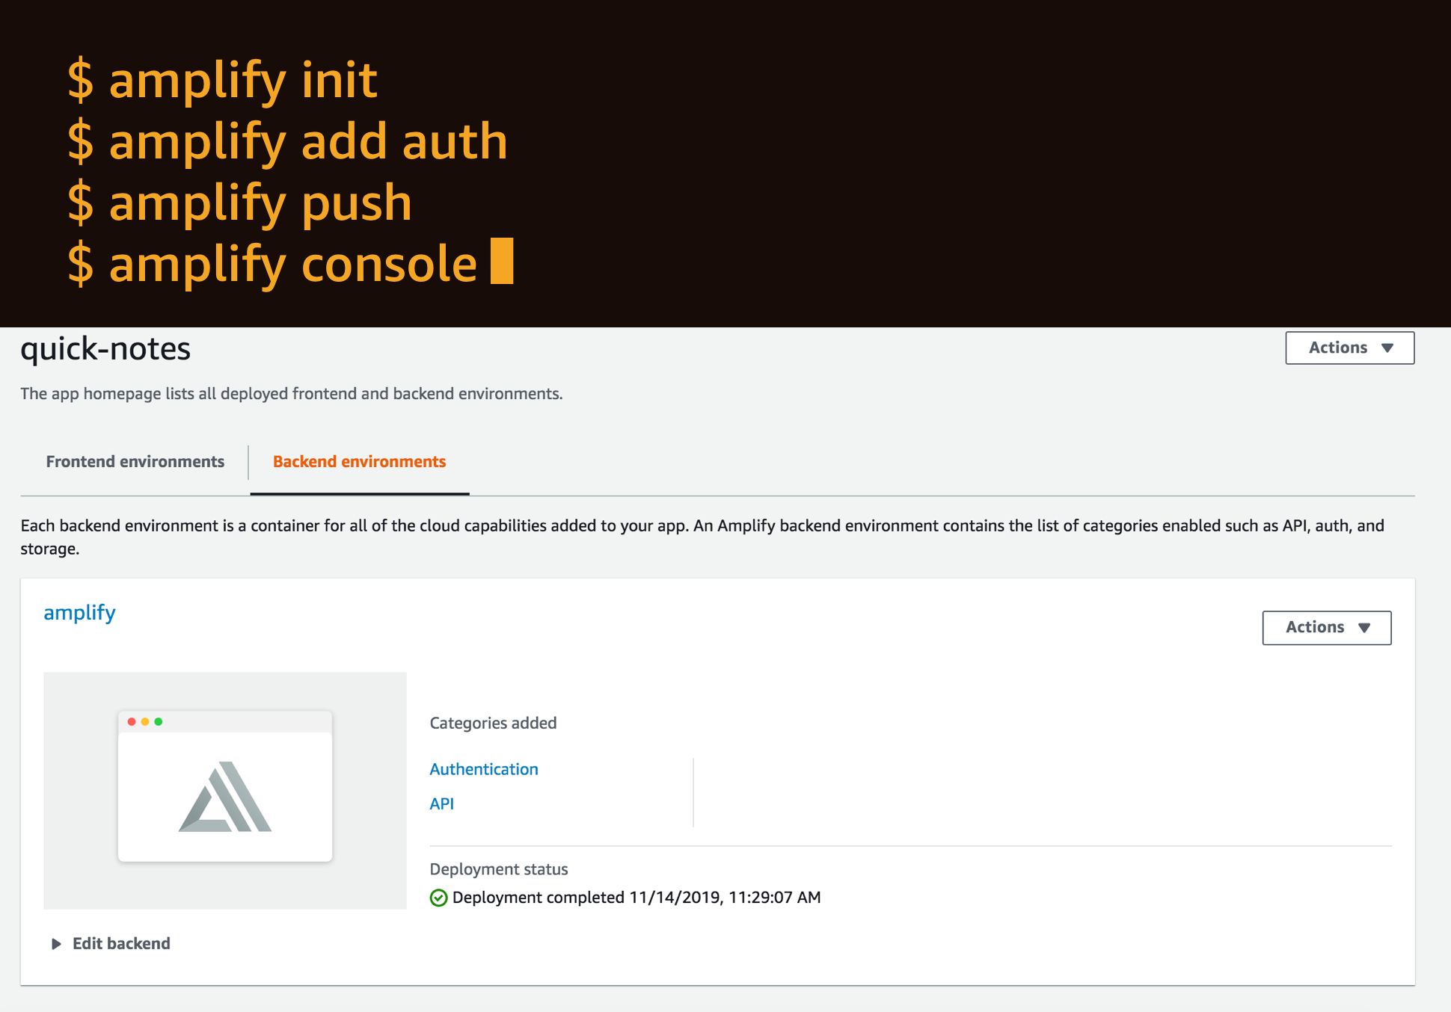
Amplify Console: Full-stack deployments (new)
Git-based CI/CD for full-stack Serverless apps

Slide 24
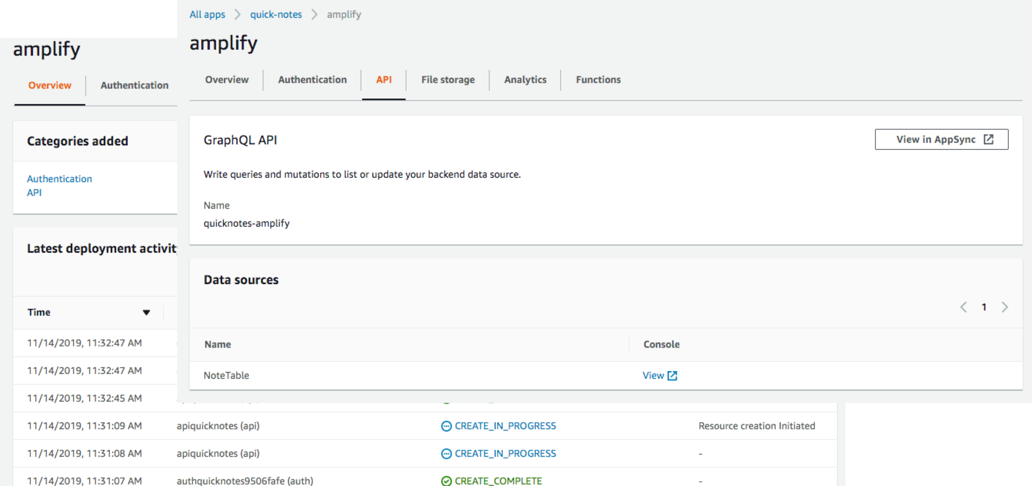
Amplify Console: Full-stack deployments (new)
Git-based CI/CD for full-stack Serverless apps

Slide 25
Data requirements

Slide 26




AWS AppSync: Real-time and offline data with GraphQL
Real-time collaboration
Offline programming model with sync
Multiple data sources
Fine-grained access control

Slide 27
Modern app requirements
Low-latency messages
Banking alerts
News stories
Multi-player games
Chat applications
Shared whiteboards
AR/VR experiences
Document collaboration
Offline sync
Financial transactions
New articles
Games
Chat
Document collaboration

Slide 28


Mental model: App data
const cache=[];
cache.put({
key : value
});
cache.map((k,v) => {
<p> {k.value} </p>
});

Slide 29




Introducing
Amplify DataStore
Multi-platform (iOS/Android/React Native/Web) on-device persistent storage engine that automatically synchronizes data between mobile/web apps and the cloud using GraphQL
Automatic versioning, conflict detection, and resolution in the cloud
Familiar and local first programming model
Delta sync and auto-merge
Powered by AWS AppSync and GraphQL

Slide 30
Demo

Slide 31
Amplify Predictions

Slide 32
Amplify Framework
Predictions category
Easily add AI/ML use cases powered by Amazon AI/ML services
No machine learning experience required
Few lines of code
Support for custom models through SageMaker
Apple CoreML Vision Framework support for iOS
@predictions to orchestrate multiple AI/ML actions using GraphQL
Notes:
You can invoke the SageMaker models via a REST API.
No ML required.

Slide 33
Amplify Framework
Predictions category use cases
Translating text
Text to speech
Text recognition
Entities recognition
Label real world objects
Interpretation of text
Uploading images for automatic training
Transcribing text
Notes:
You can invoke the SageMaker models via a REST API.
No ML required.

Slide 34
Notes:
You can invoke the SageMaker models via a REST API.
No ML required.

Slide 35
Notes:
You can invoke the SageMaker models via a REST API.
No ML required.

Slide 36
Notes:
You can invoke the SageMaker models via a REST API.
No ML required.

Slide 37
Questions

Slide 38
Thank you !

